Slide 1

Micro Credit Defaulter Project
BY: ARGHA KR MAITI

Slide 2
Objective:
Building a model which can be used to predict in terms of a probability for each loan transaction, whether the customer will be paying back the loaned amount within 5 days of insurance of loan. In this case, Label ‘1’ indicates that the loan has been paIed i.e. Non- defaulter, while, Label ‘0’ indicates that the loan has not been paIed i.e. defaulter.

Slide 3
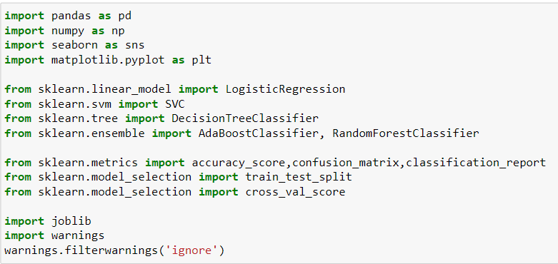
importing required libraries and database:

Slide 4
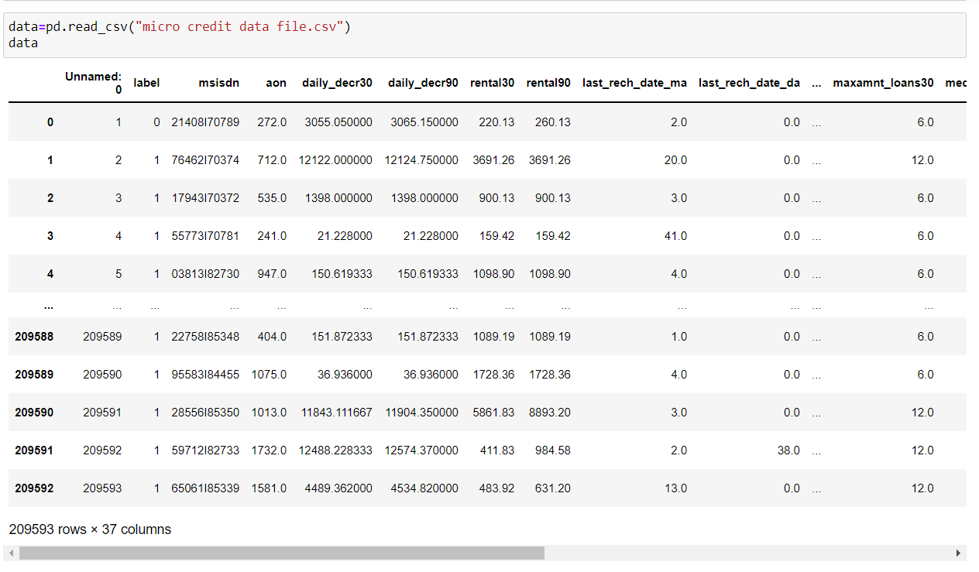
Our dataset has 209593 rows and 37 columns.

Slide 5
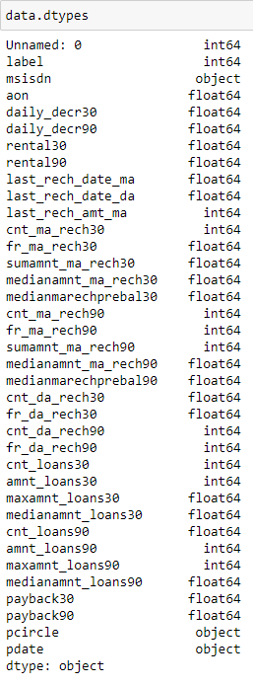
Other than msisdn, pcircle and pcircle all other columns are numerical i.E., Float and integer.
Also we can drop column Unnamed: 0 as it contains serial number only, mobile number and pdate is also not required for further analysis.
We have only one unique value in pcircle hence we can drop that column.
We don’t have null values in our database.
In our database we have some columns with data of 30 days as well as 90 days. Last 90 days data obviously include data of 30 days, Hence I have dropped columns with 30 days data.

Slide 6
Visualization:

Slide 7
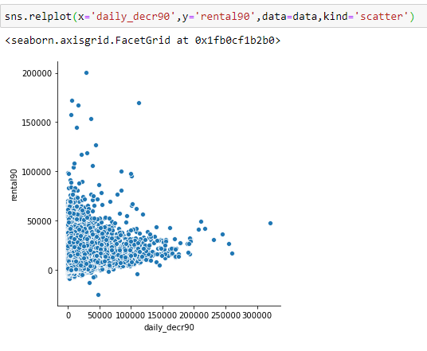
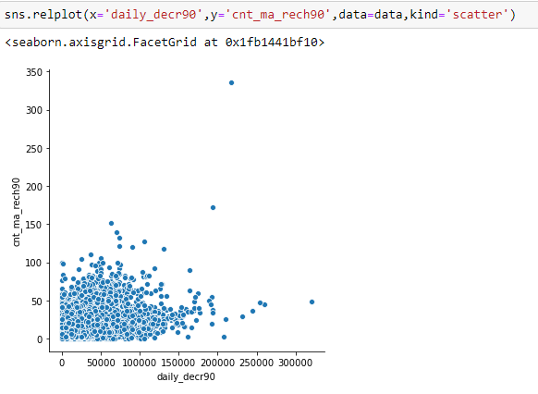
We can see positive relation between daily_decr90 and rental90. Maximum data for daily_decr90 is in range till 150000 and for rental90 its till 100000.
Relation between daily_decr90 and cnt_ma_rech90 is also somewhat positive. Maximum amount for daily decr90 is ranging till 13000 and for cnt_ma_rech90 count is 100.

Slide 8
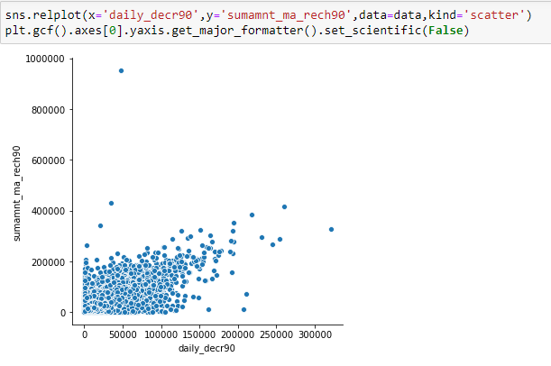
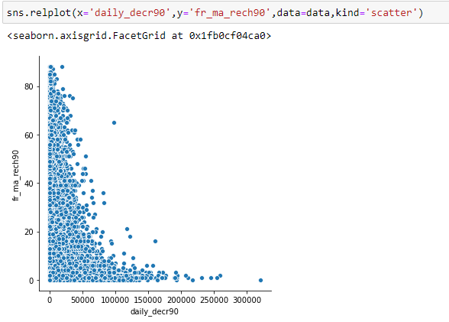
Relation between daily_decr90 and sumamnt_ma_rech0 is also positive. Maximum amounts for daily decr is ranging till 15000 and for sumamnt_ma_rech30 its till 20000.
Relation between daily_decr90 and fr_ma_rech90 is also somewhat negative. Maximum amounts for daily decr90 is ranging till 150000 and for fr_ma_rech90 counts are spread over the entire range.

Slide 9
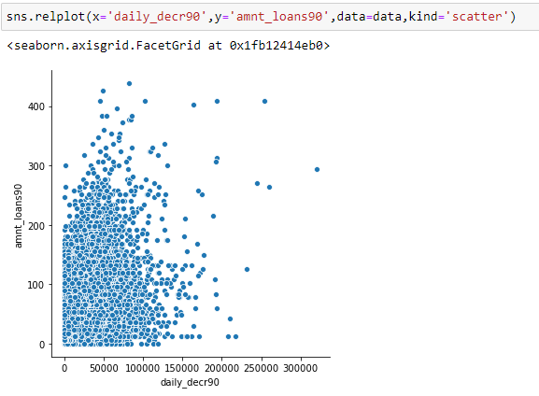
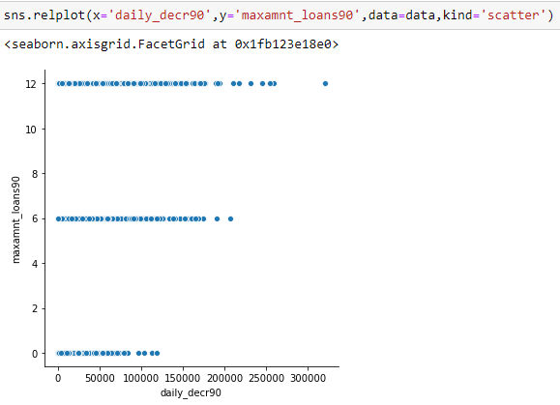
Relation between daily_decr90 and amnt_loans90 is also somewhat positive. Maximum amounts for daily decr90 is ranging till 15000 and for amnt_loans90 its till 300 counts.
When pmonth is 6 then daily_decr90 ranging at 0, when pmonth is 7 then daily_decr90 is ranging till 180000 and when pmonth is 8 then daily_decr90 is ranging till 250000.

Slide 10
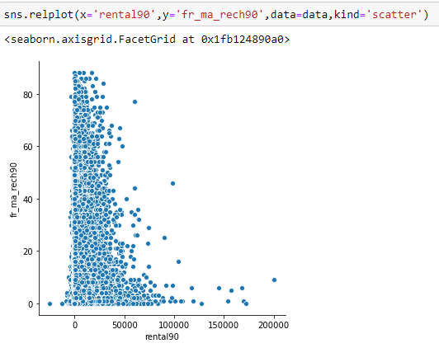
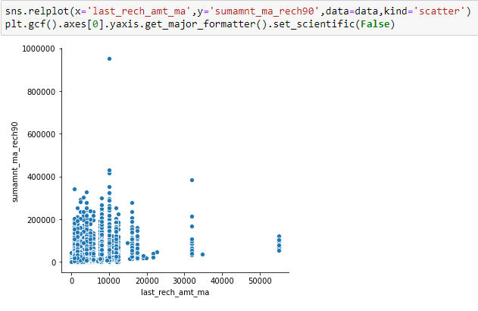
Relation between rental90 and fr_ma_rech90 is negative. Data for fr_ma_rech90 is spread over the entire range.
Relation between last_rech_amt_ma and last_rech_amt_ma is positive. Maximum amount of data for last_rech_amt_ma is ranging till 20000

Slide 11
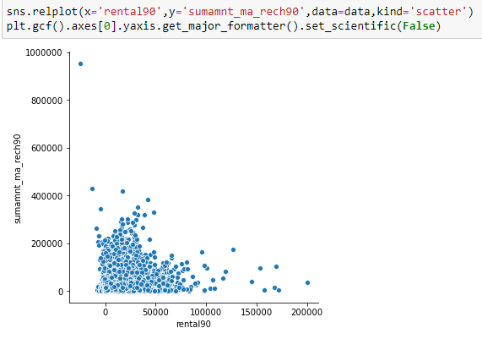
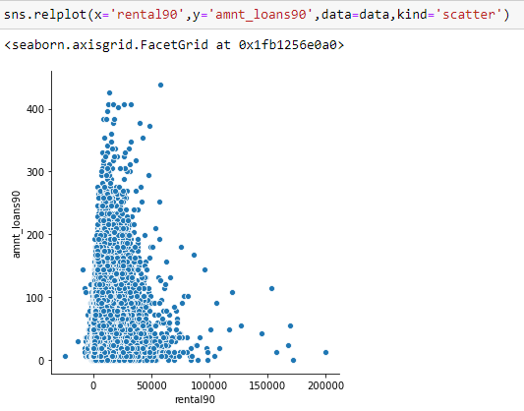
For rental90 data is maximum number of data is ranging till 80000 and sumamnt_ma_rech30 its till 300000
For amnt_loans90 data is spread over the entire range and for rental90 maximum data is ranging till 80000.

Slide 12
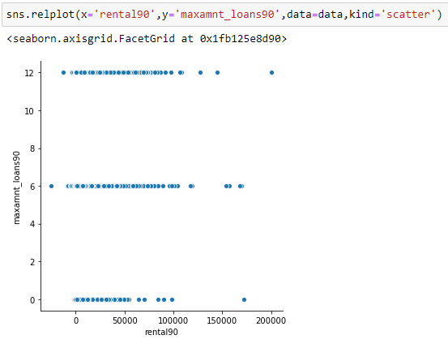
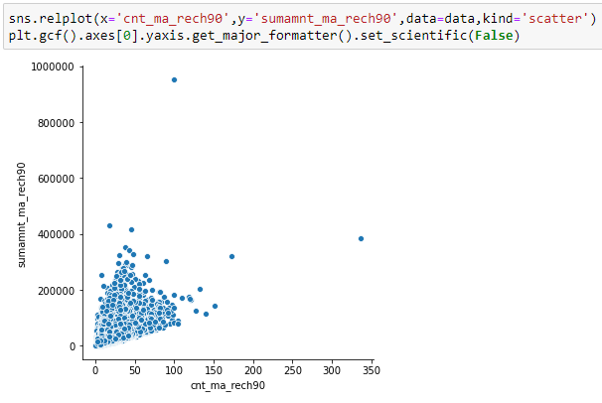
When maxamnt_loans90 is 0 then maximum amount of rental90 is ranging till 100000, When maxamnt_loans90 is 6 then maximum amount rental90 is ranging till 120000 and When maxamnt_loans90 is 12 then maximum amount of rental90 is ranging till 120000.
For cnt_ma_rech90 maximum data is ranging till 100 and for sumamnt_ma_rech90 maximum data is ranging till 300000. We can a see positive relation between cnt_ma_rech90 and sumamnt_ma_rech90.

Slide 13
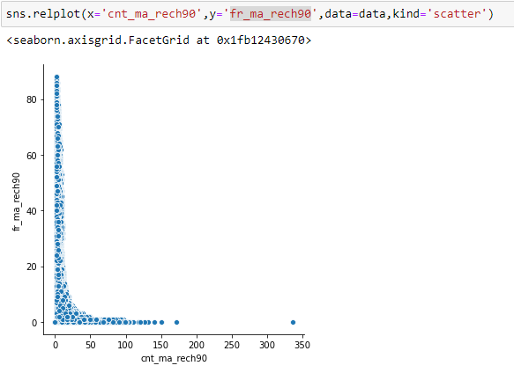
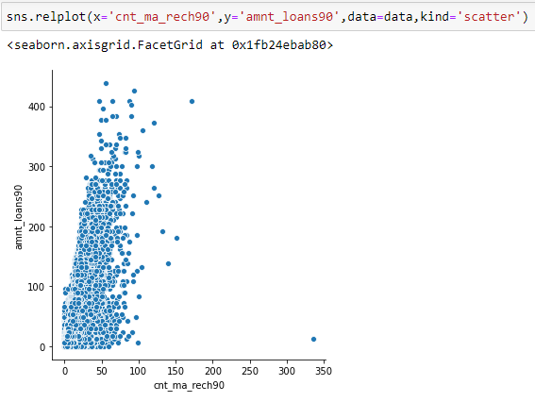
For fr_ma_rech90 data is spread over the entire range and for cnt_ma_rech90 maximum data is ranging till 150. The Relationship between cnt_ma_rech90 and fr_ma_rech90 is somewhat negative.
For amnt_loans90, data is spread over the entire range and for amnt_loans90 maximum data is till range 100.

Slide 14
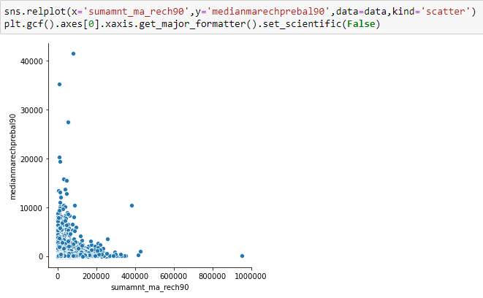
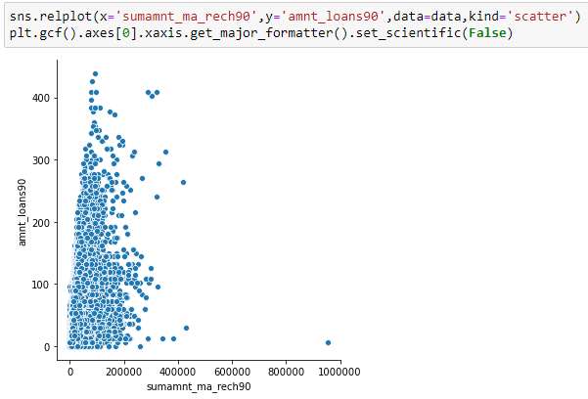
For sumamnt_ma_rech90 maximum data is ranging till 380000 and for medianmarechprebal90 maximum data is ranging till 15000.
For sumamnt_ma_rech90 maximum data is ranging till 300000 and for amnt_loans90 data is spread over the entire range.

Slide 15
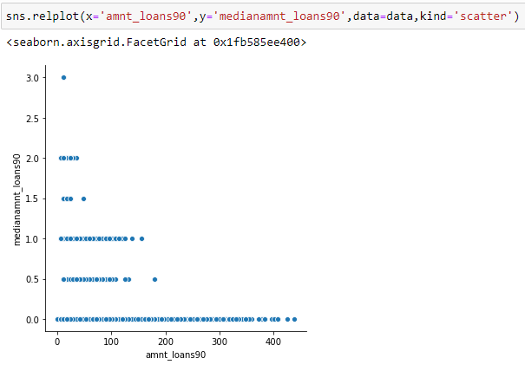
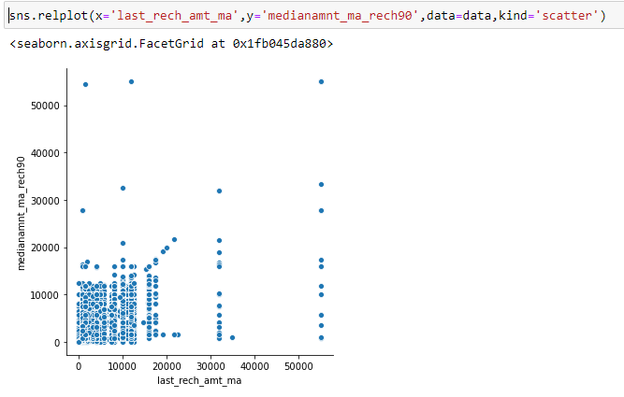
When medianamnt_loans90 is 0 then amnt_loans90 is spread over the entire range, When medianamnt_loans90 is 0.5 then amnt_loans90 is ranging till 130, When medianamnt_loans90 is 1.0 then amnt_loans90 is ranging till 180, When medianamnt_loans90 is 1.5 then amnt_loans90 is ranging till 50, When medianamnt_loans90 is 2.0 then amnt_loans90 is ranging till 50, and When medianamnt_loans90 is 3.0 then amnt_loans90 is ranging till 10.
For last_rech_amt_ma maximum data till the range 20000 and medianamnt_ma_rech90 its till 20000

Slide 16
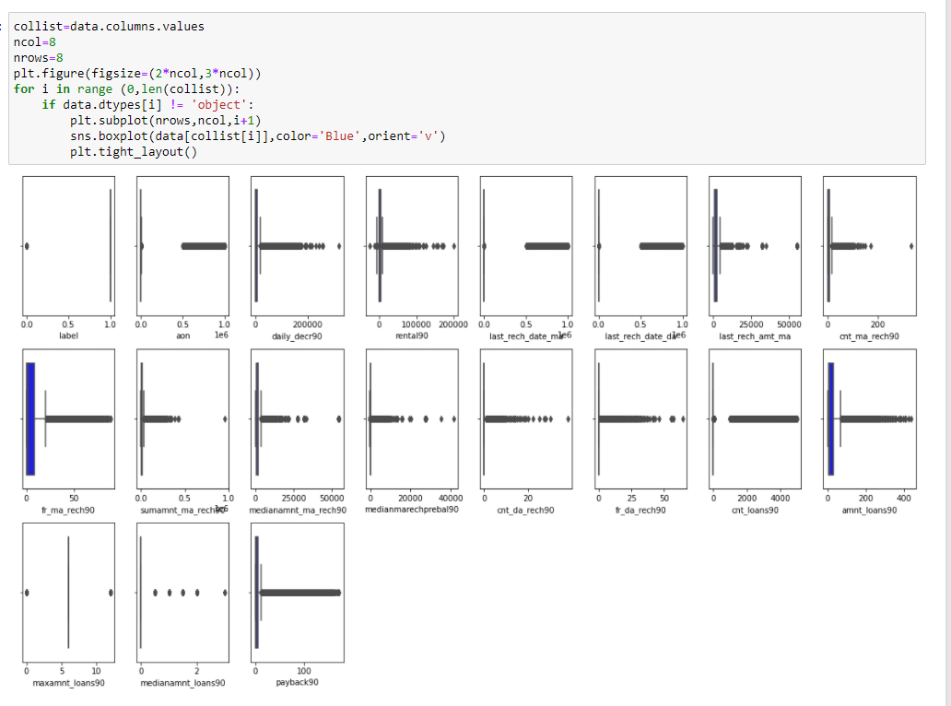
Outliers:
We can see outliers in many columns, Let’s check individually and then work on the same.

Slide 17
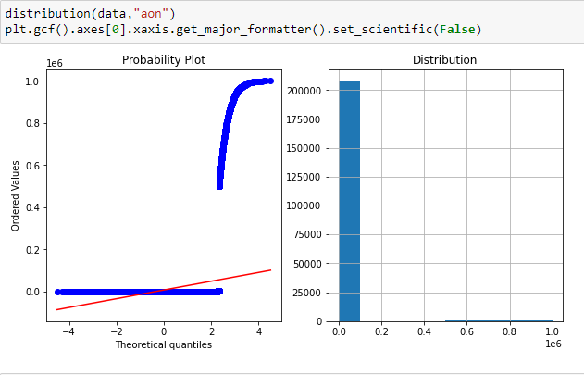
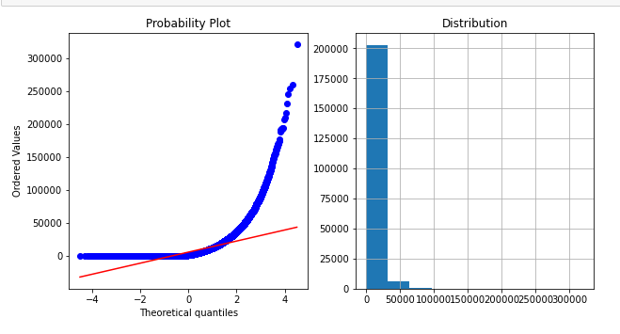
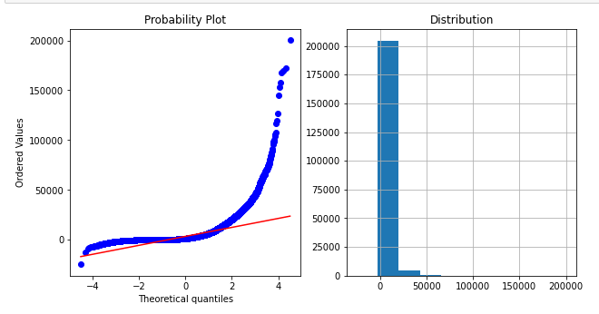
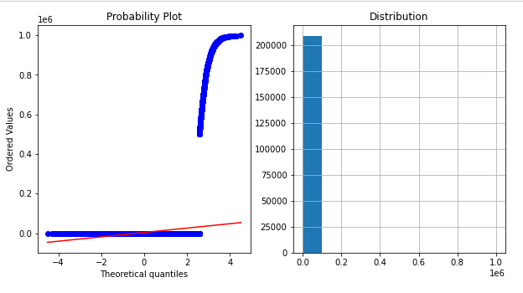
Check the distribution and work on outliers:
aon
daily_decr90
rental90
last_rech_date_ma

Slide 18
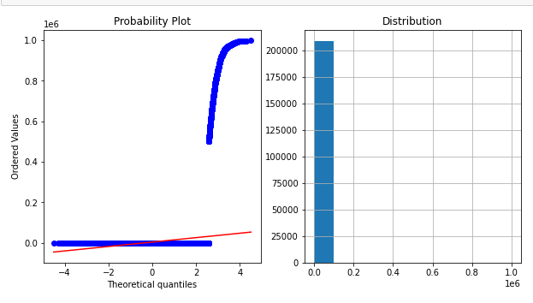
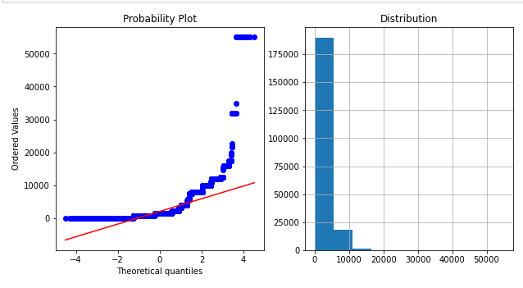
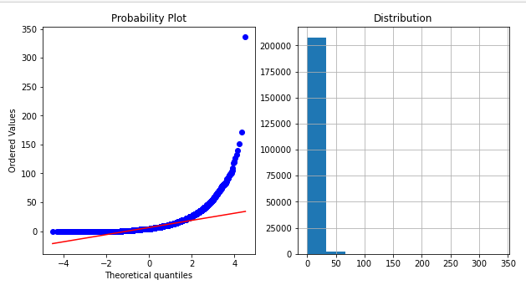
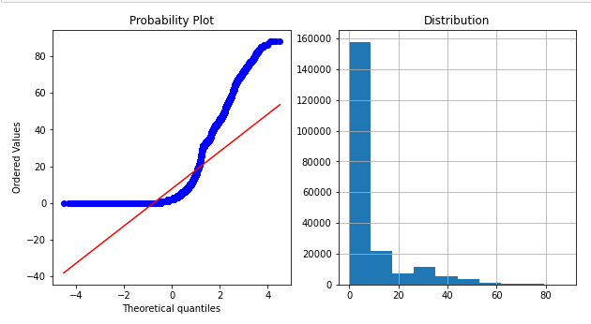
last_rech_date_da
last_rech_amt_ma
cnt_ma_rech90
fr_ma_rech90

Slide 19
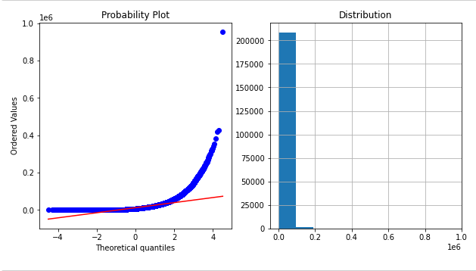
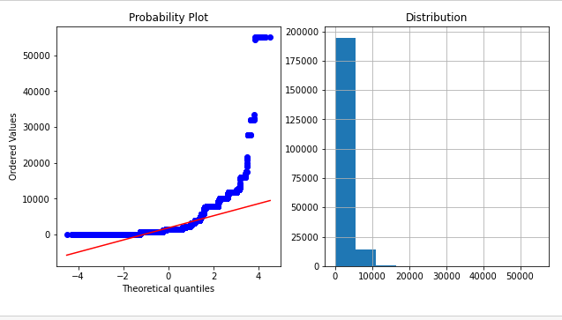
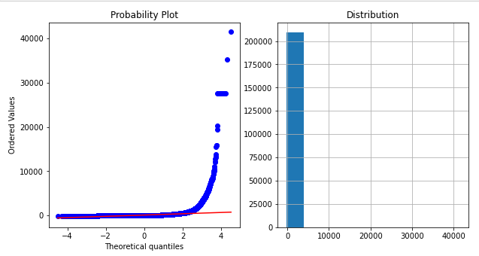
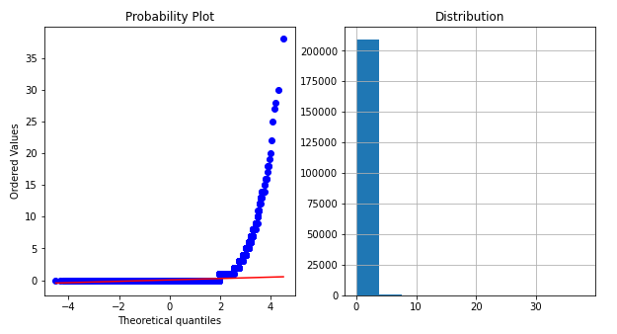
sumamnt_ma_rech90
medianamnt_ma_rech90
medianmarechprebal90
cnt_da_rech90

Slide 20
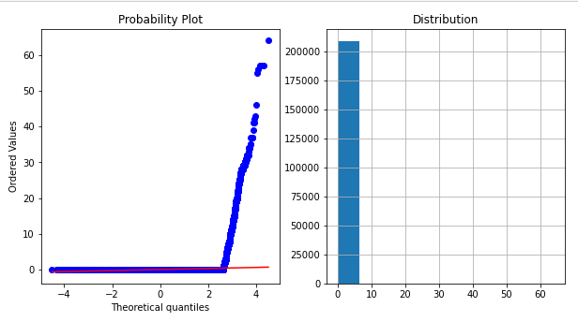
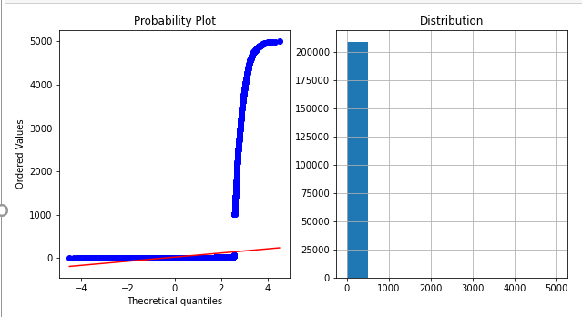
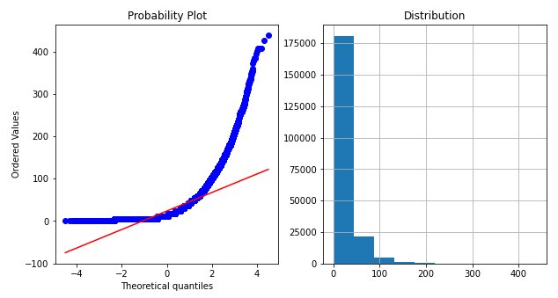
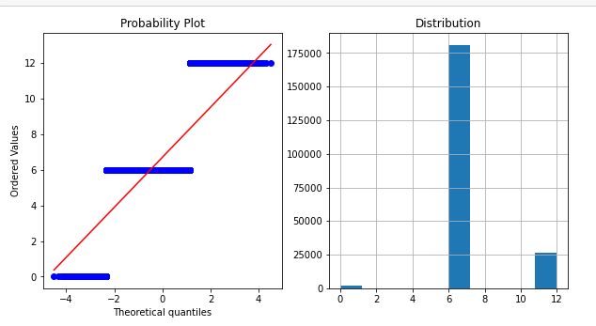
fr_da_rech90
cnt_loans90:
amnt_loans90:
maxamnt_loans90

Slide 21
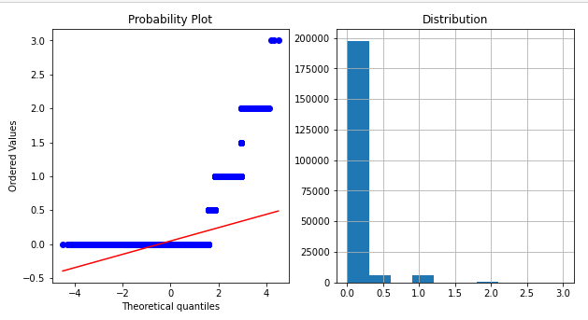
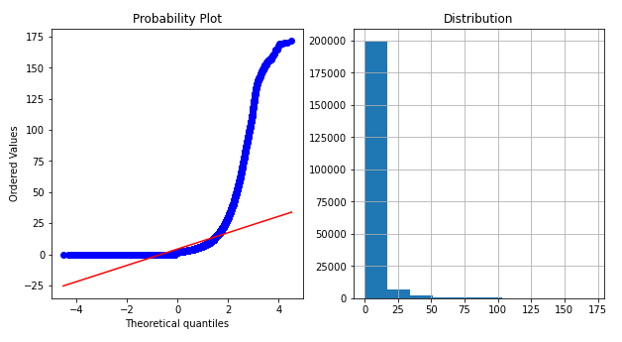
medianamnt_loans90
payback90

Slide 22
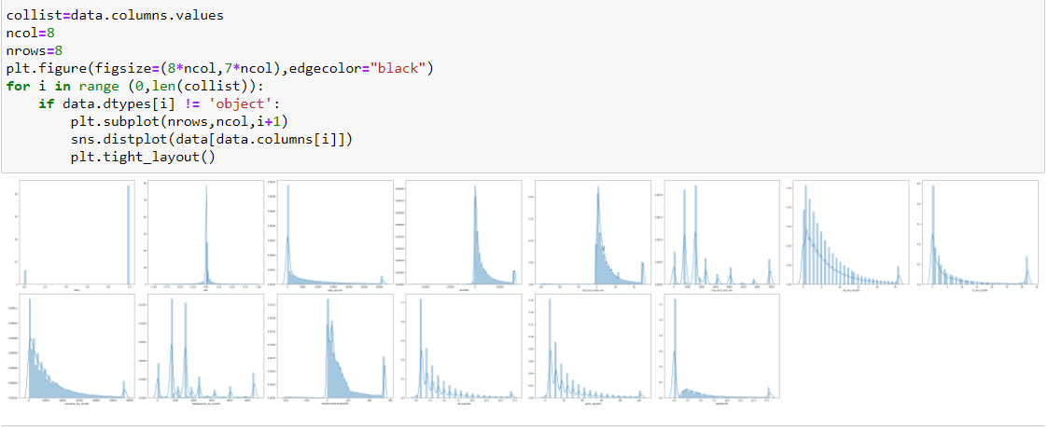
Let’s check the distribution with the help of distplot:

Slide 23
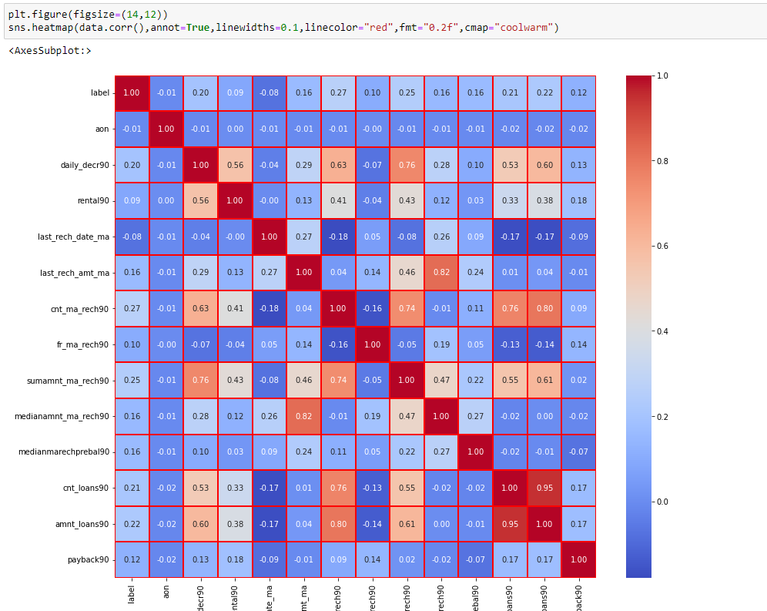
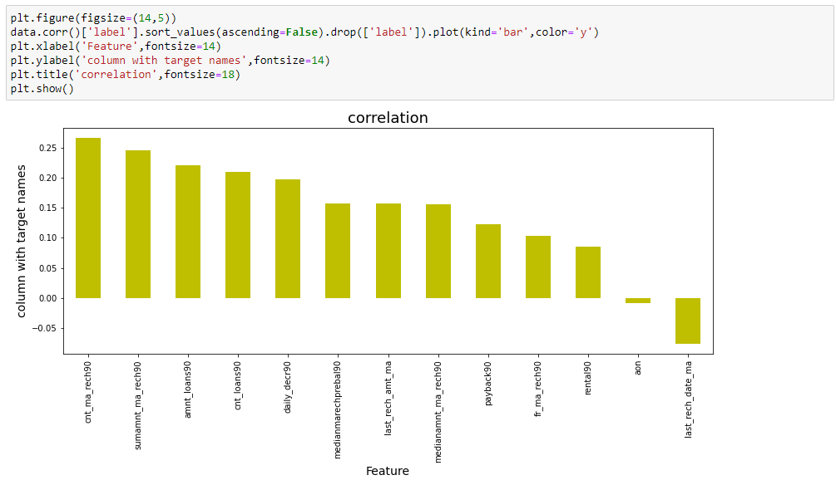
Let’s check the correlation with the help of heat map:
aon columns have very less correlation with our target column, hence I have dropped that column.

Slide 24
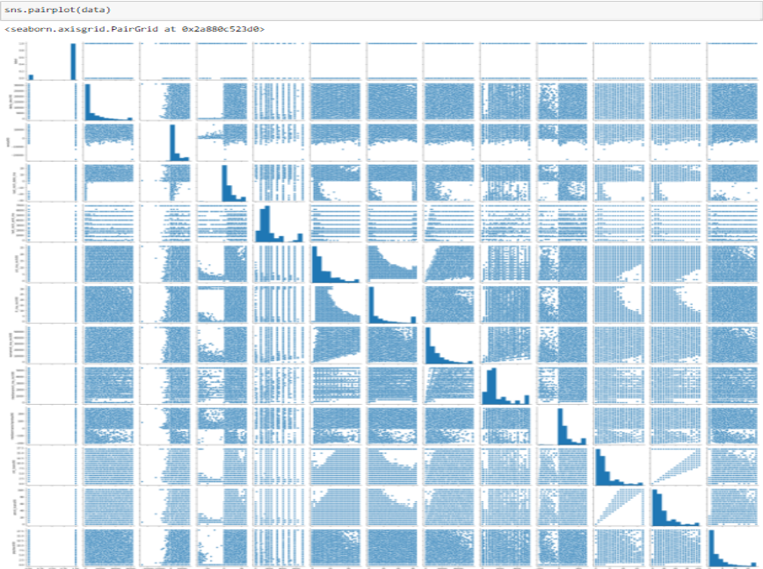
Let’s look at pairplot:

Slide 25
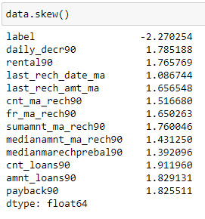
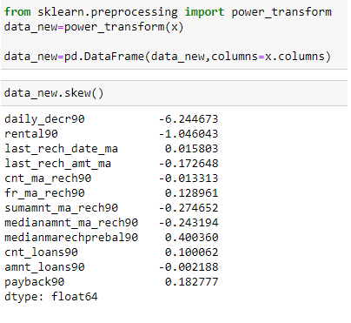
Skewness checking
Skewness removal
I have already Dealt with outliers

Slide 26
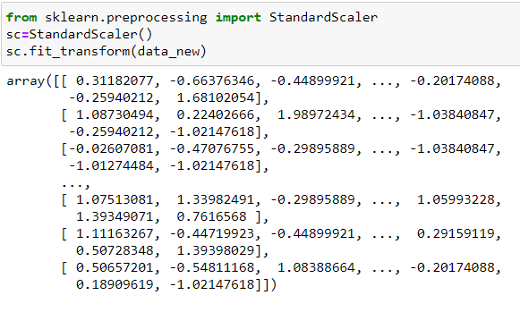
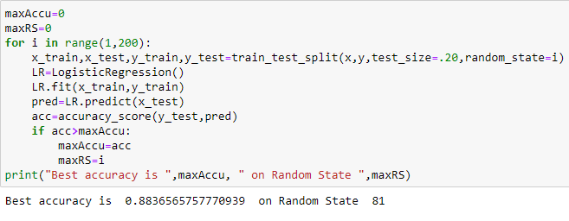
Scaling:
Finding best random state:

Slide 27
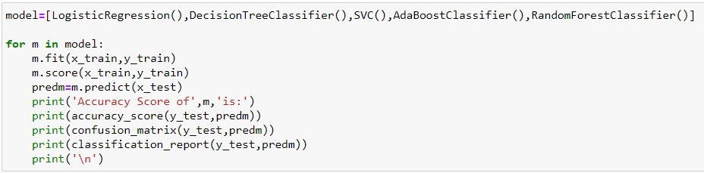
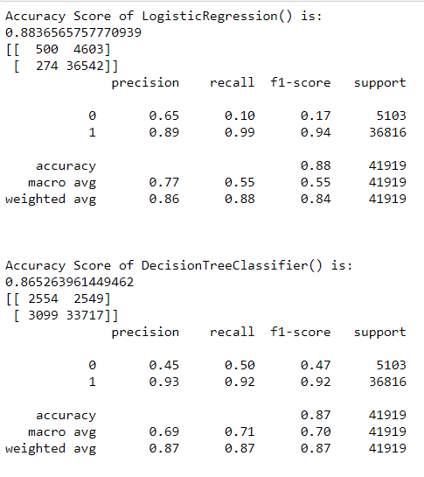


Model/s Development and Evaluation:

Slide 28
We can see AdaBoostClassifier has 90.67% accuracy with 91 f1 score
RandomForestClassifier has 91.08% accuracy with 91 f1 score
Hence let’s do hyper parameter tunning with these two models.

Slide 29



Hyper parameter tunning:
Hyper parameter tunning with adaboost classifier gives us 90.28 % accuracy.
Hyper parameter tunning with RandomForestClassifier gives us 99.65 % accuracy.
AUC_ROC:
RandomizedSearchCV
Adaboost Classifier
RandomForestClassifier
As we got best accuracy score with RandomForest Classifier and AUC_roc score is also graph is better than another model hence I am saving that model.

Slide 30

Saving the model:

Slide 31
THANK YOU

